Slide 1


AI for Audio
From Processing
To Generation
Music Separation & Voice Interaction using Cross-Domain Transformers
Prepared by: M. AKESKOUS Osama
Supervised by: Mrs. Ikrame Elkarfi
1
Notes:
1

Slide 2
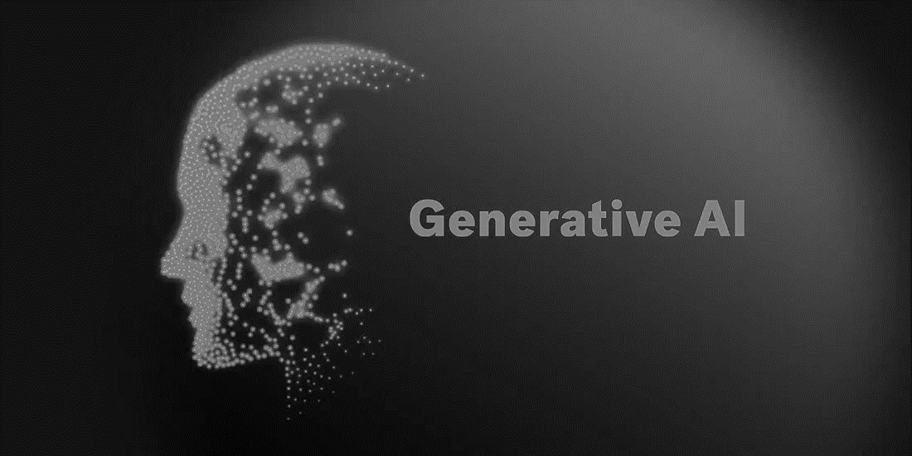

Plan
1 . Introduction
2 . Problem Statement
Model
3 . Proposed Solution
4 . Proposed Project Workflow
5 . Model Used and Dataset
6 . Technologies Used
Notes:
2

Slide 3
Introduction
Model
Notes:
3

Slide 4
Problem Statement
In the this section, we will explain the main challenge this project aims to solve: how to use advanced AI to separate different sounds in music and make the system easy to control using voice commands.
Model
Ai
Notes:
4

Slide 5
Problem Statement
In the this section, we will explain the main challenge this project aims to solve: how to use advanced AI to separate different sounds in music and make the system easy to control using voice commands.
Model
AI
Notes:
5

Slide 6


Mixture Music
Problem Statement
In the this section, we will explain the main challenge this project aims to solve: how to use advanced AI to separate different sounds in music and make the system easy to control using voice commands.
Model
AI
Notes:
6

Slide 7




Mixture Music
Problem Statement
In the this section, we will explain the main challenge this project aims to solve: how to use advanced AI to separate different sounds in music and make the system easy to control using voice commands.
Model
Separated Music
AI
Notes:
7

Slide 8

Problem Statement
Model
In the this section, we will explain the main challenge this project aims to solve: how to use advanced AI to separate different sounds in music and make the system easy to control using voice commands.
AI
Separated Music
Notes:
8

Slide 9
Open settings
Notes:
9

Slide 10
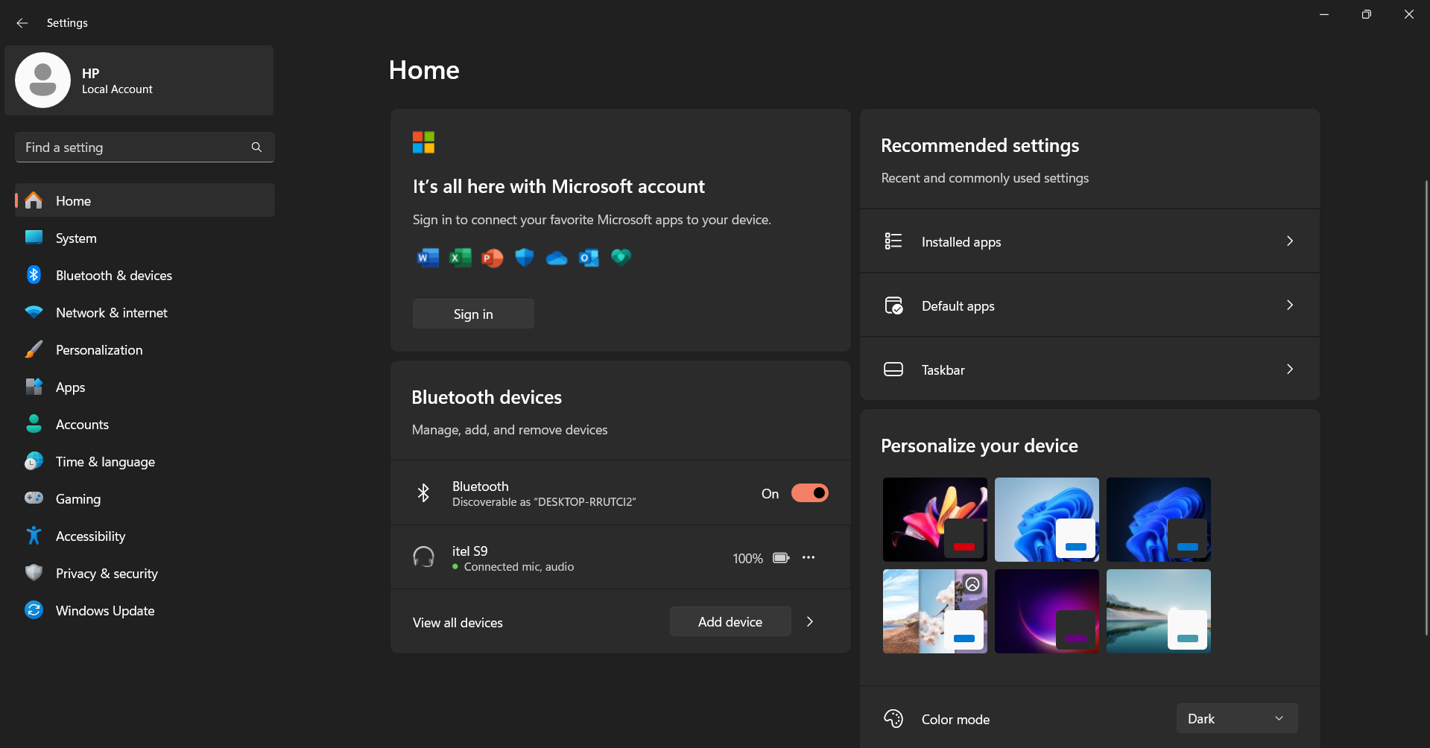

Open settings
In the this section, we will explain the main challenge this project aims to solve: how to use advanced AI to separate different sounds in music and make the system easy to control using voice commands.
Notes:
10

Slide 11
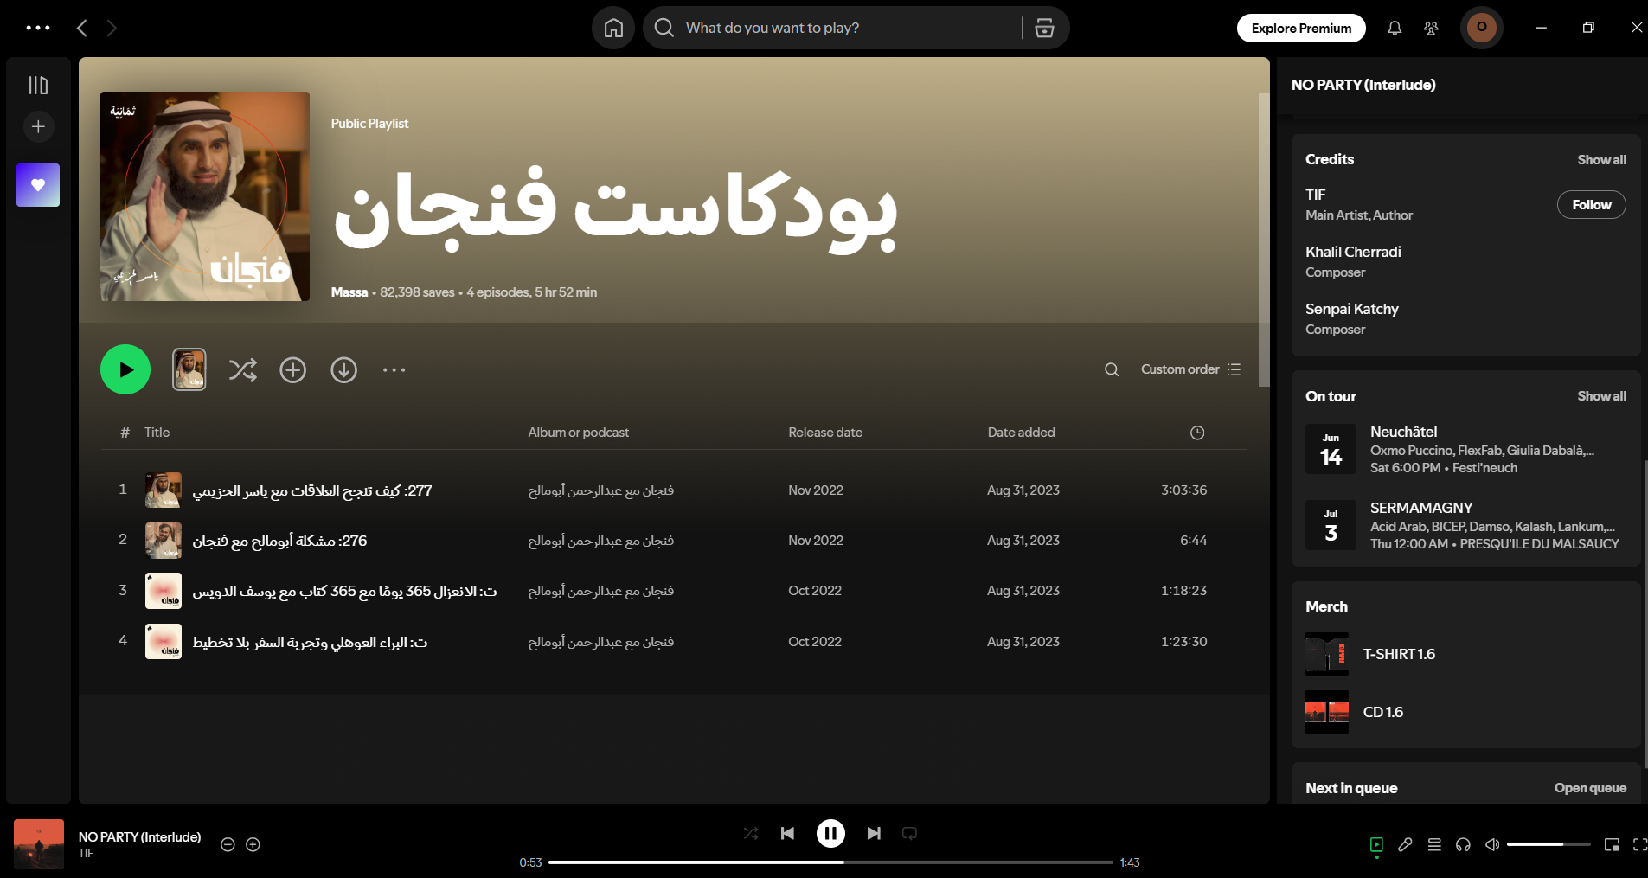

In the this section, we will explain the main challenge this project aims to solve: how to use advanced AI to separate different sounds in music and make the system easy to control using voice commands.
The app includes a smart location detection feature.
By using GPS or network data, it can find out where you are.
Just say "Where am I?" and the system gives your location.
This makes the assistant more helpful and context-aware.
Notes:
11

Slide 12
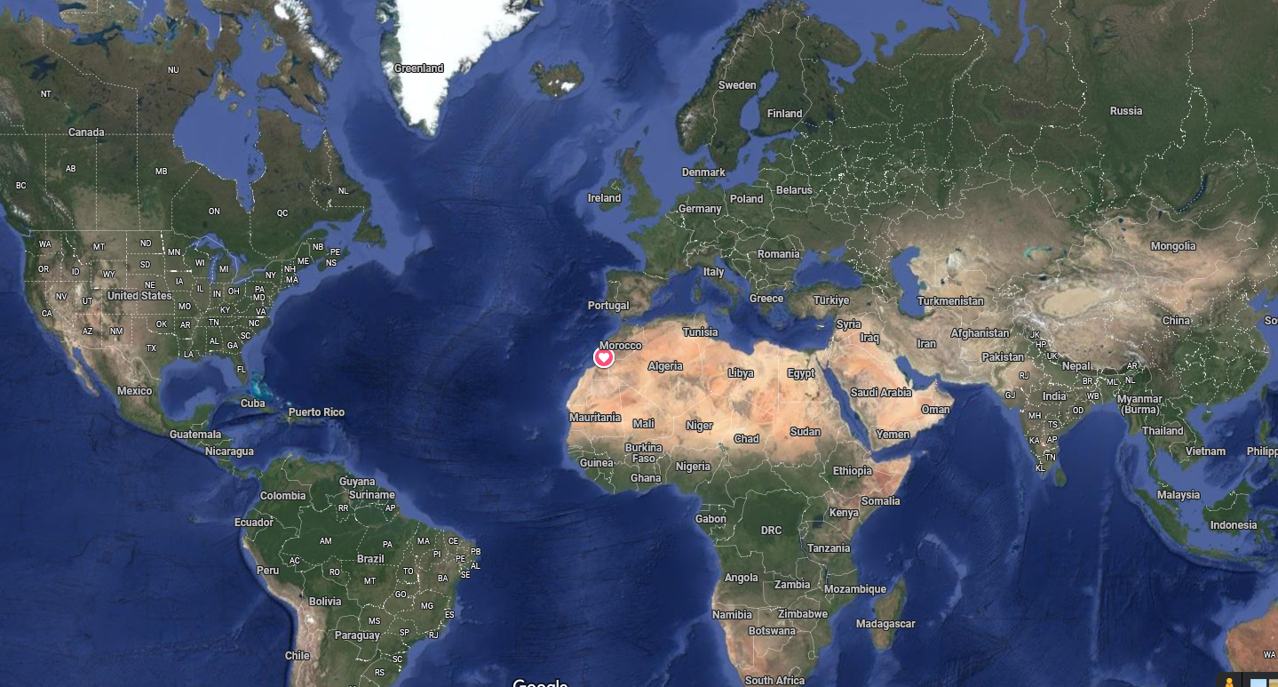

In the this section, we will explain the main challenge this project aims to solve: how to use advanced AI to separate different sounds in music and make the system easy to control using voice commands.
The app includes a smart location detection feature.
By using GPS or network data, it can find out where you are.
Just say "Where am I?" and the system gives your location.
This makes the assistant more helpful and context-aware.
Notes:
12

Slide 13

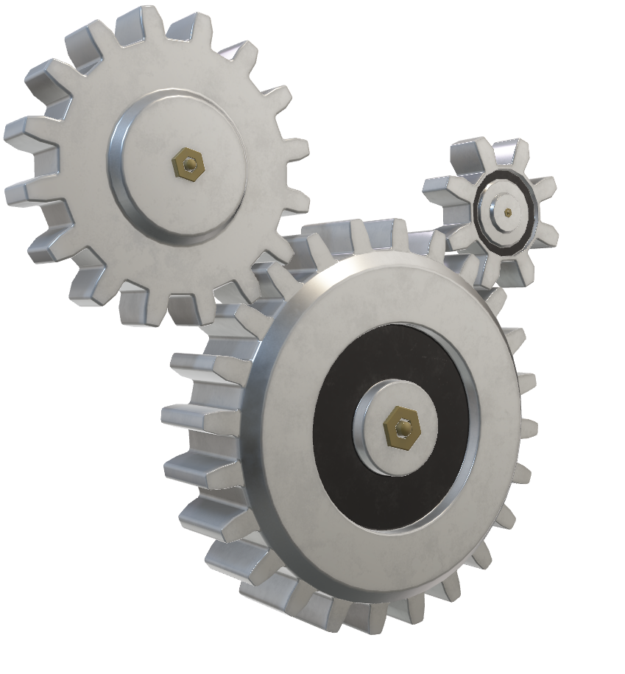
Process Signals
Proposed Solution
The idea is to turn voice commands into text so the computer can understand and do what the user says. At the same time, we use AI—specifically transformer models—to separate music into parts like vocals, drums, and instruments. This creates a smart system that combines voice control with powerful music separation.
AI
Separate Music
Notes:
13

Slide 14


Process Signals
Proposed Solution
The idea is to turn voice commands into text so the computer can understand and do what the user says. At the same time, we use AI—specifically transformer models—to separate music into parts like vocals, drums, and instruments. This creates a smart system that combines voice control with powerful music separation.
Malaysia
Separate Music
Notes:
14

Slide 15

Proposed Solution
The idea is to turn voice commands into text so the computer can understand and do what the user says. At the same time, we use AI—specifically transformer models—to separate music into parts like vocals, drums, and instruments. This creates a smart system that combines voice control with powerful music separation.
Malaysia
Notes:
15

Slide 16
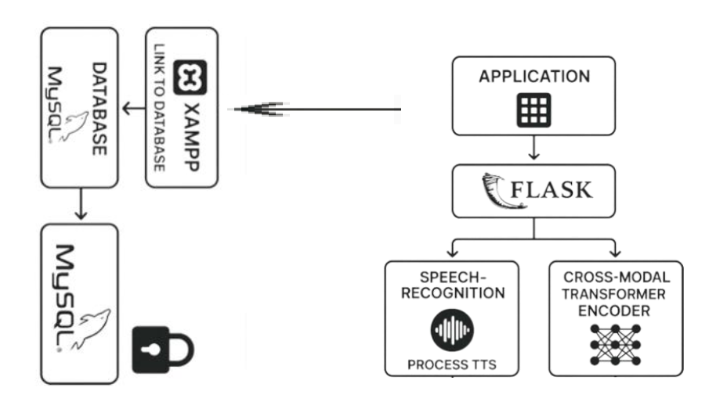
Proposed Solution
The idea is to turn voice commands into text so the computer can understand and do what the user says. At the same time, we use AI—specifically transformer models—to separate music into parts like vocals, drums, and instruments. This creates a smart system that combines voice control with powerful music separation.
Malaysia
Notes:
16

Slide 17
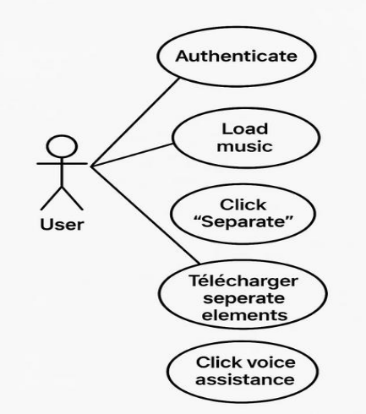
Project Workflow
In this section, we will explain the architecture of the application by showing how its different parts work together—from user login and voice commands to music separation and audio output.
Malaysia
Notes:
17

Slide 18
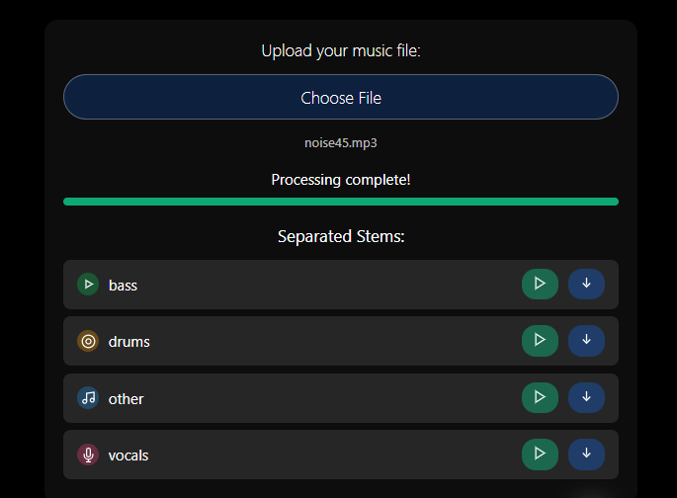
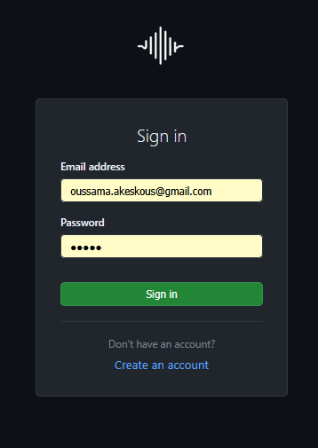
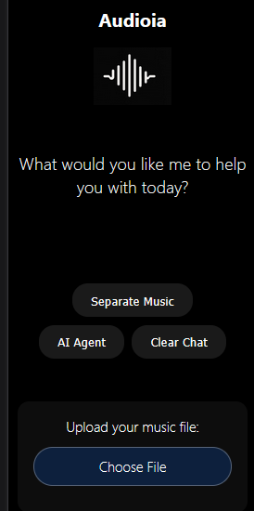
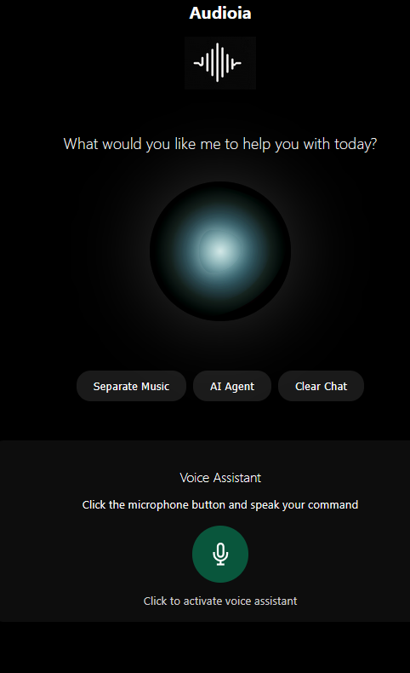
Notes:
18

Slide 19
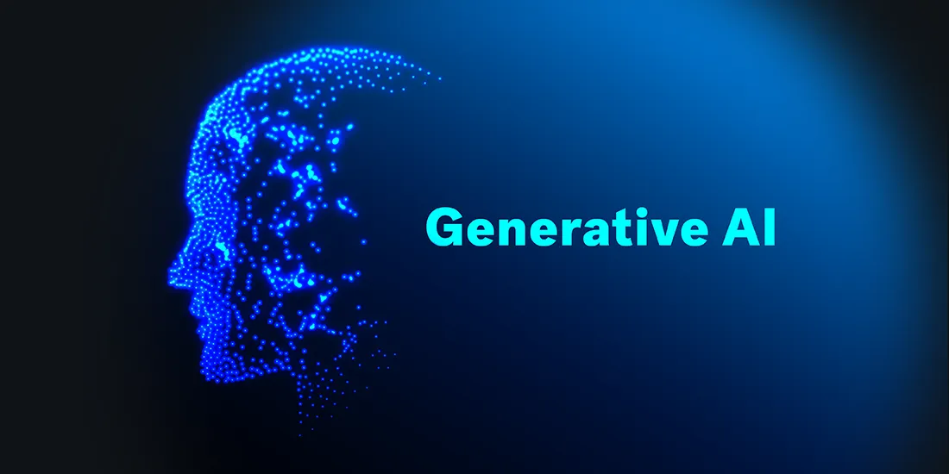


Model Used and Dataset
Notes:
19

Slide 20
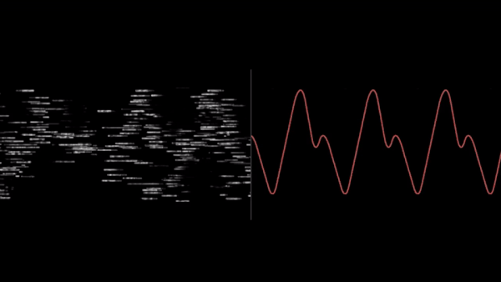
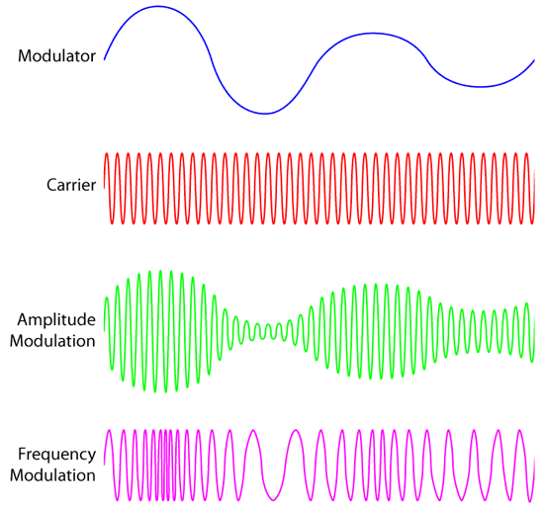
Model
Cross-Domain Transformer Encoder
Input
Cross-Domain Transformer Encoder
Output
Input
Signals
Model
Seprated
Notes:
20

Slide 21
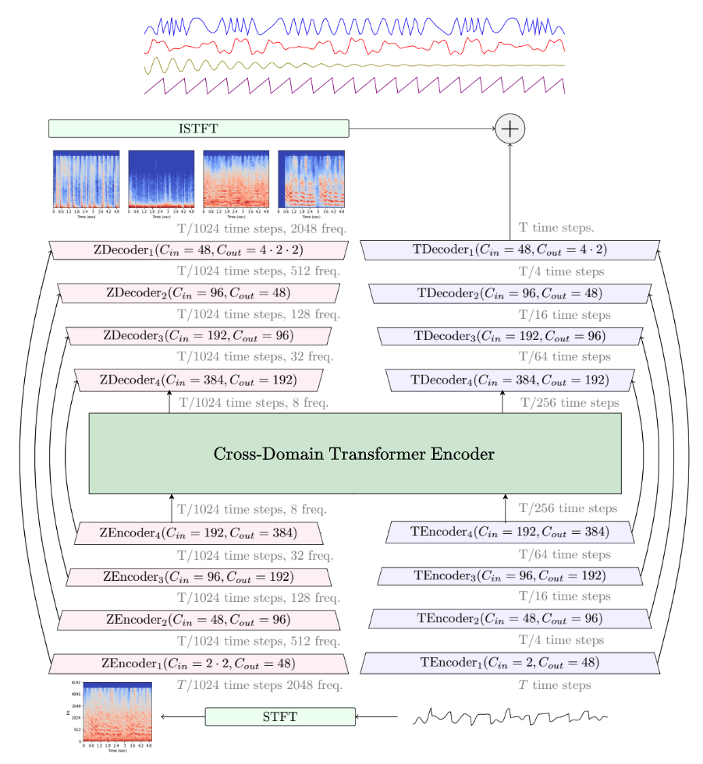
Model
Input
Notes:
21

Slide 22
Model
Cross-Domain Transformer Encoder
Output
Input
Notes:
22

Slide 23
Conclusion
Notes:
23

